Slide 1
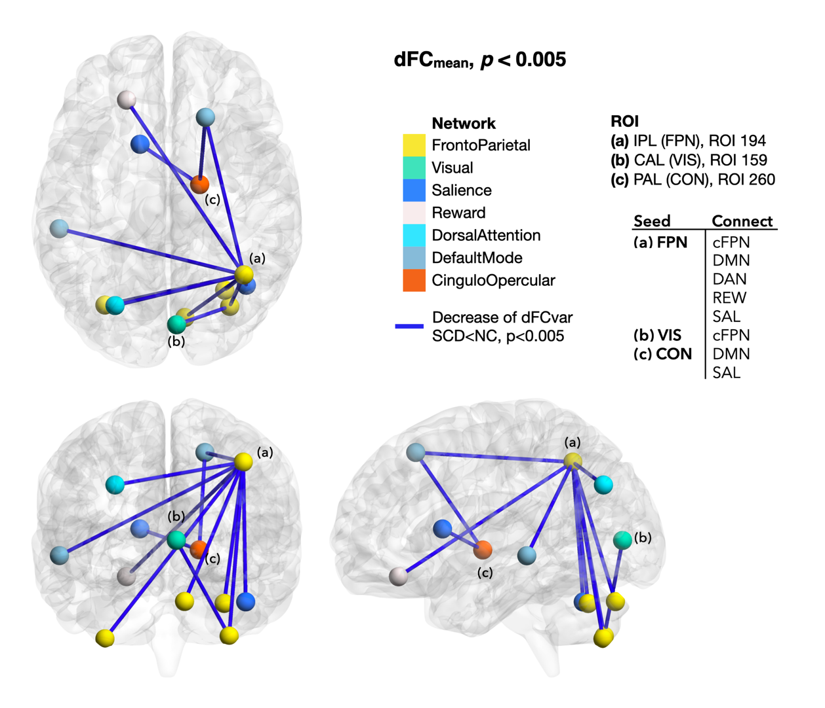
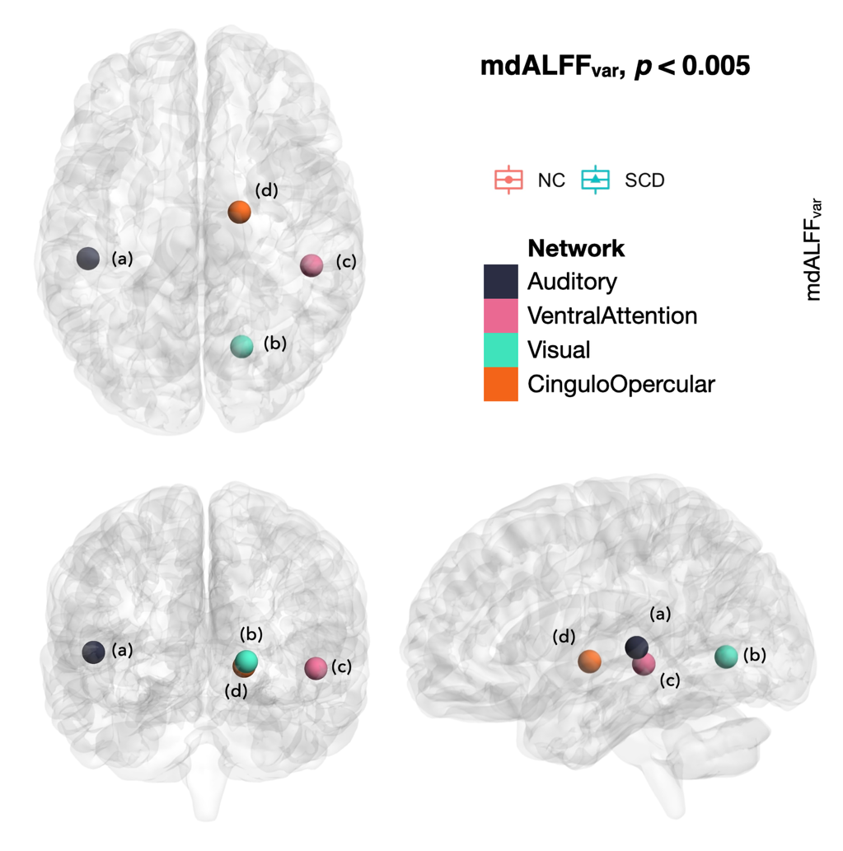
Data format
metric scores
AD8 (主觀認知障礙)
MOCA (客觀認知帳號)
HADS (焦慮程度)
data shape
1 x 300 (mdALFF)
300 x 300 (dFCmean)

Slide 2
Experiment
model
SVM、RF、LGBM、DNN
data num
85 patient

Slide 3
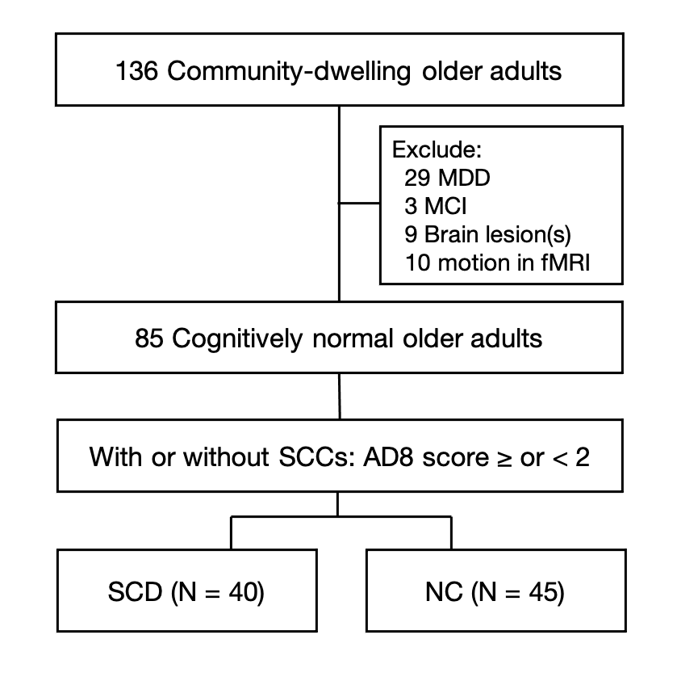

Slide 4
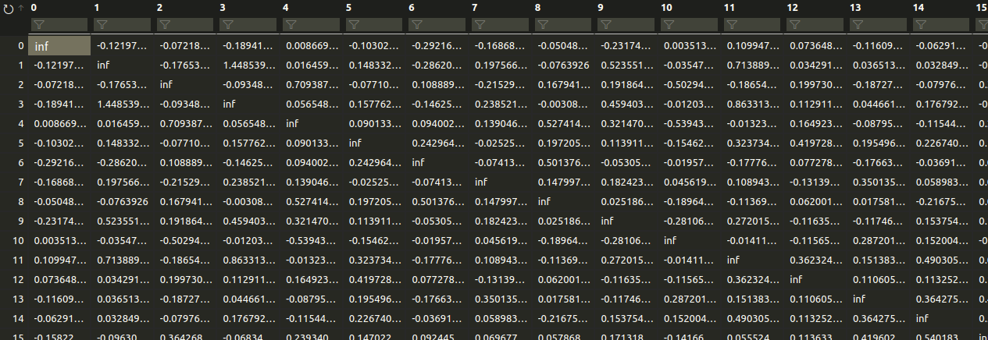

Slide 5
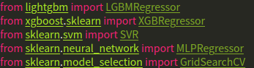
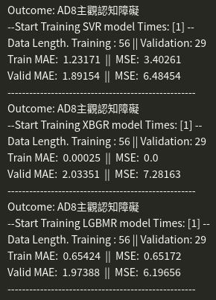
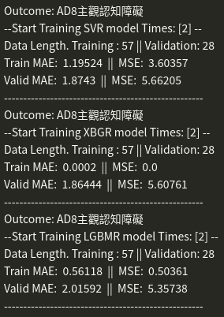
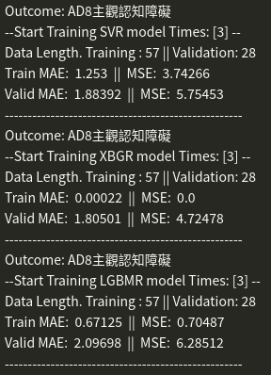
mdALFF demo 1 - 3 fold [initialization model]

Slide 6
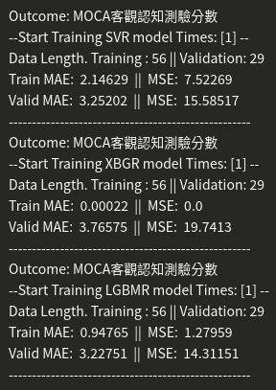
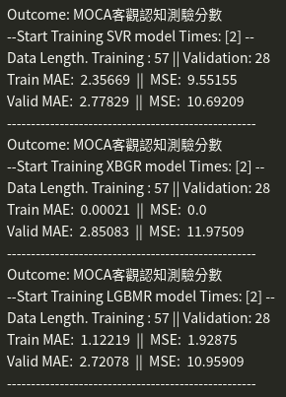
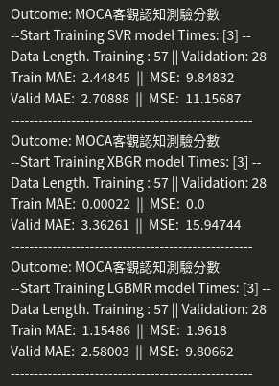
mdALFF demo 2 - 3 fold [initialization model]

Slide 7
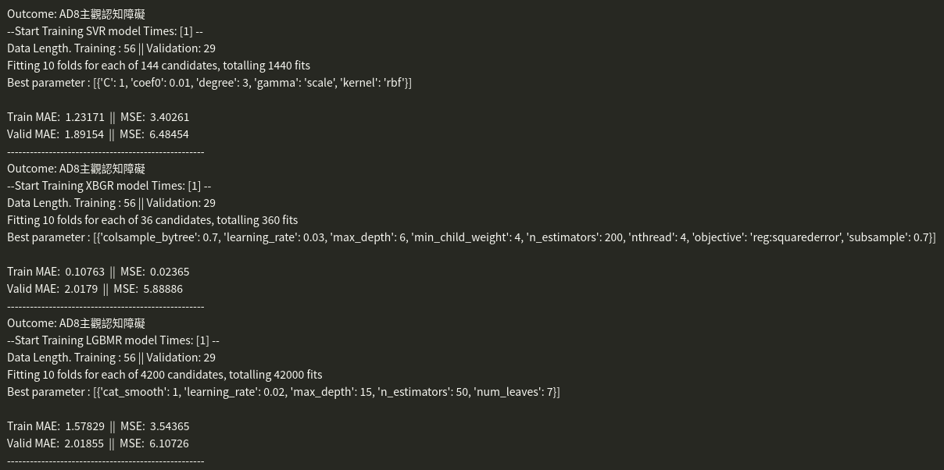
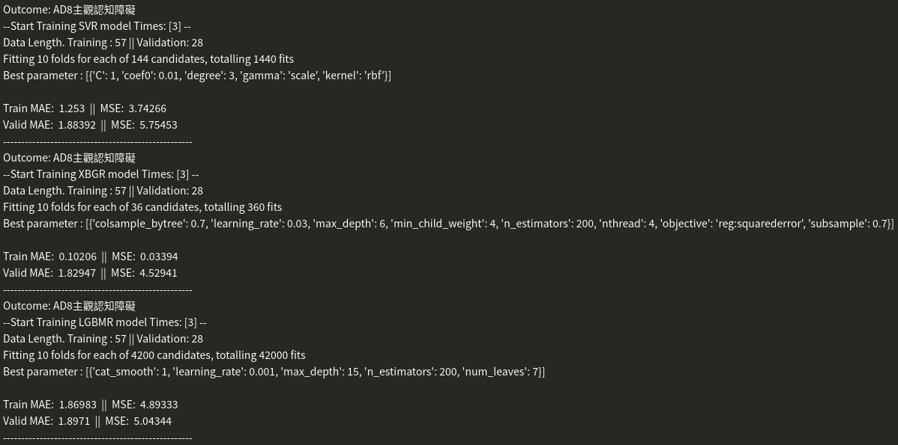
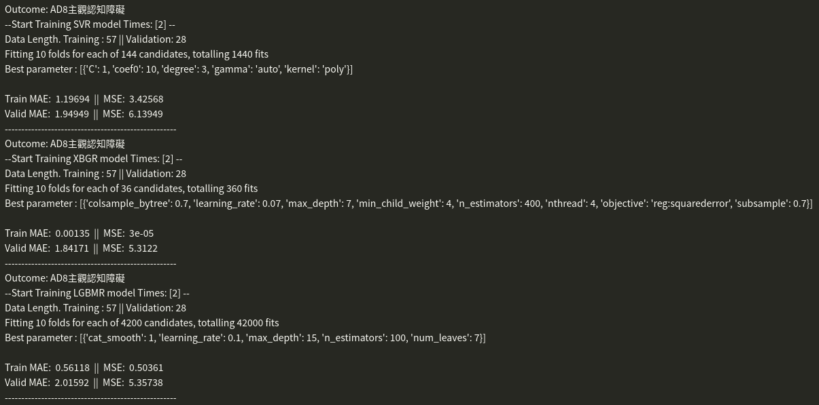
mdALFF demo - 3 fold [GridSearch model]

Slide 8
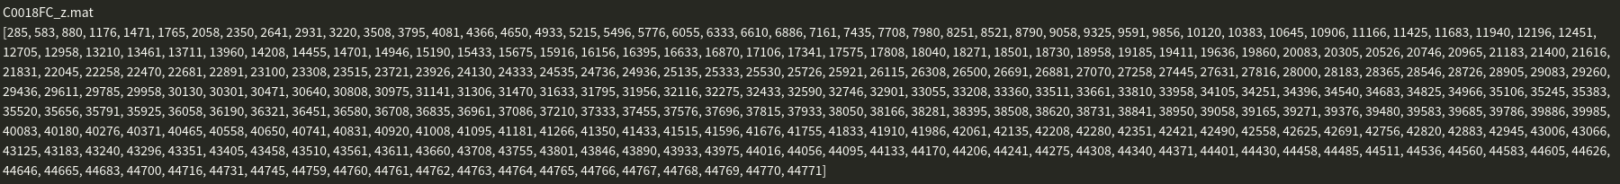
value Nan

Slide 9
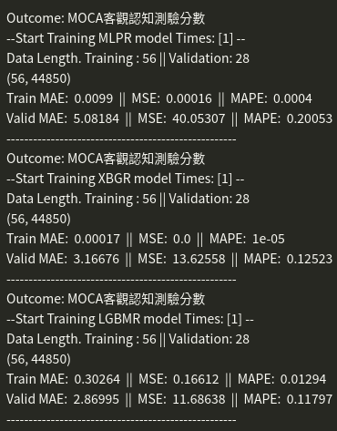
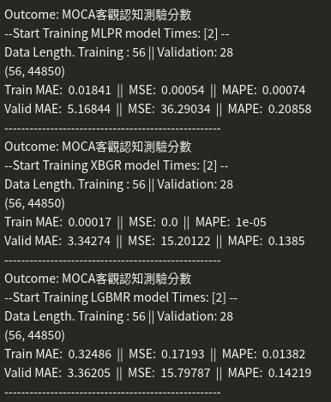
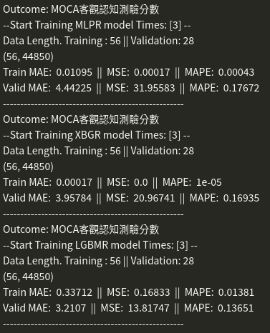
dFC demo

Slide 10
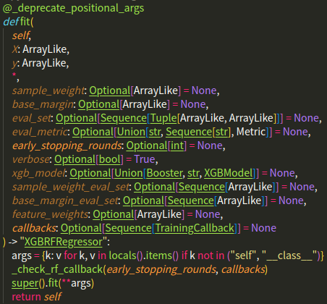
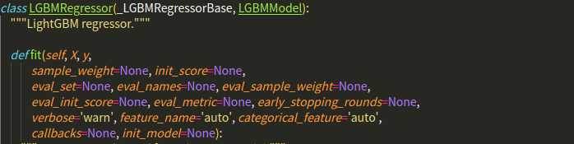
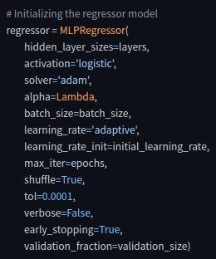
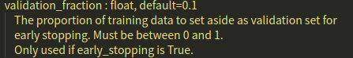
model config problem
XGBRegressor
LGBMegressor
MLPegressor

Slide 11
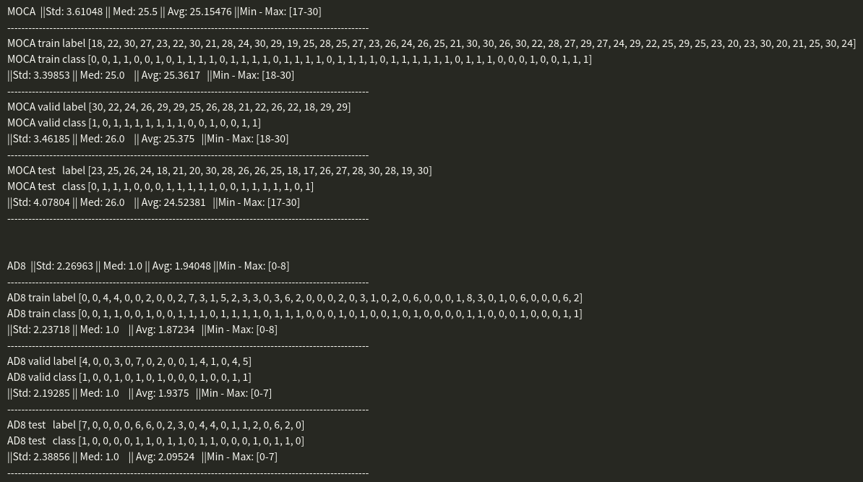
train test balance data

Slide 12
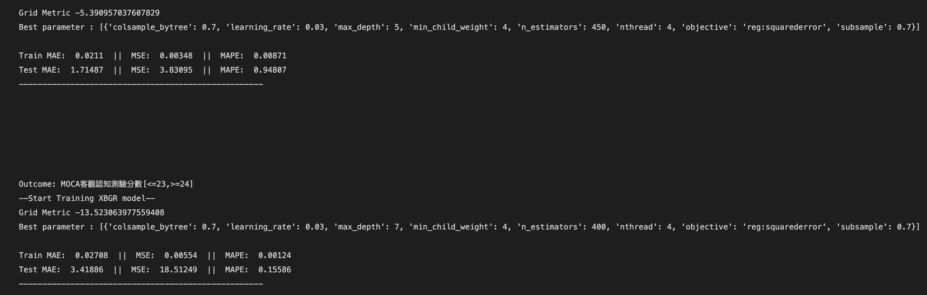

Slide 13
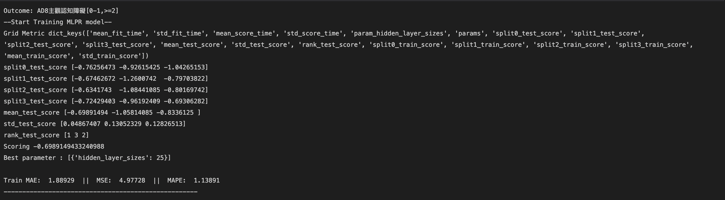
Gridsearch cv param result dict

Slide 14
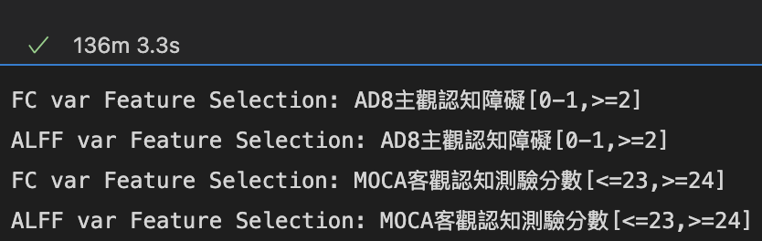
BorutaPy – Feature Selection for Regression

Slide 15
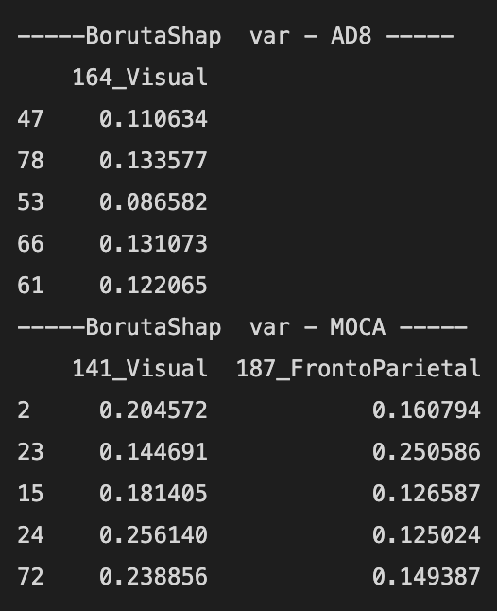
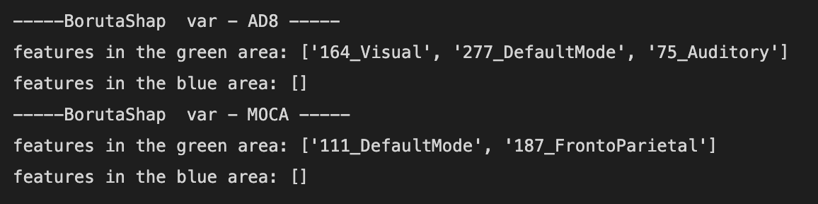
Boruta Shape – ALFF Var Result

Slide 16
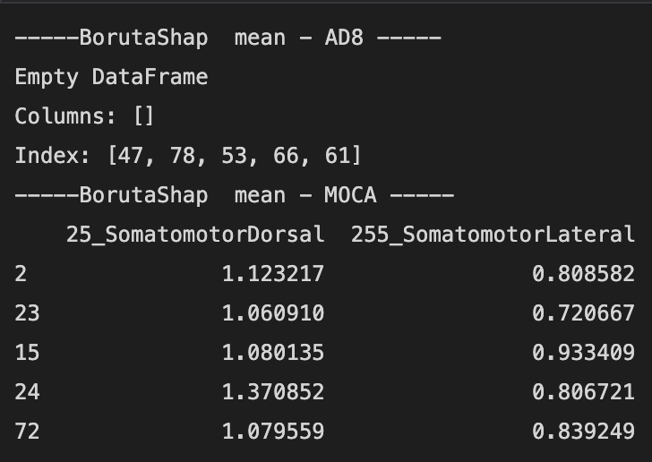
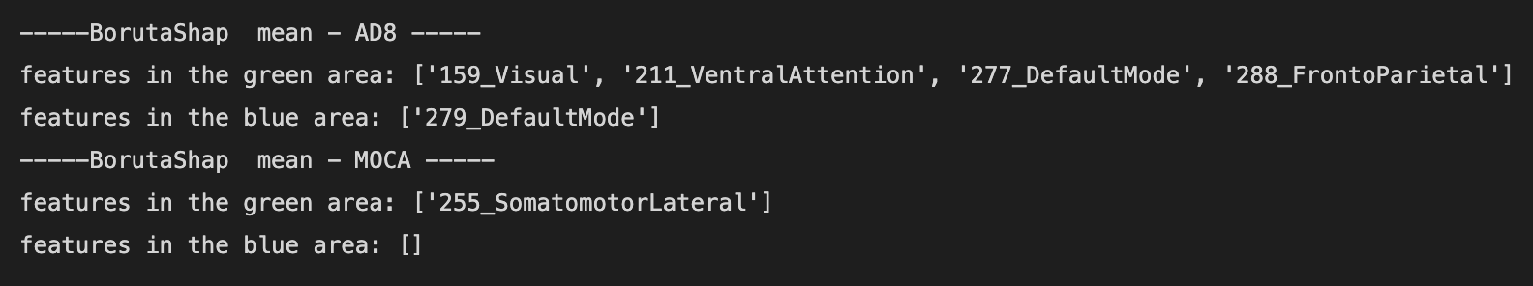
Boruta Shape – ALFF Mean Result

Slide 17
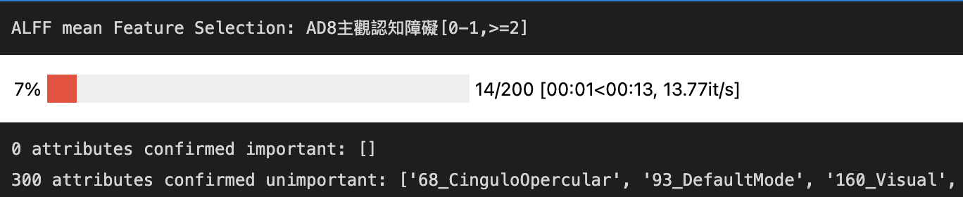
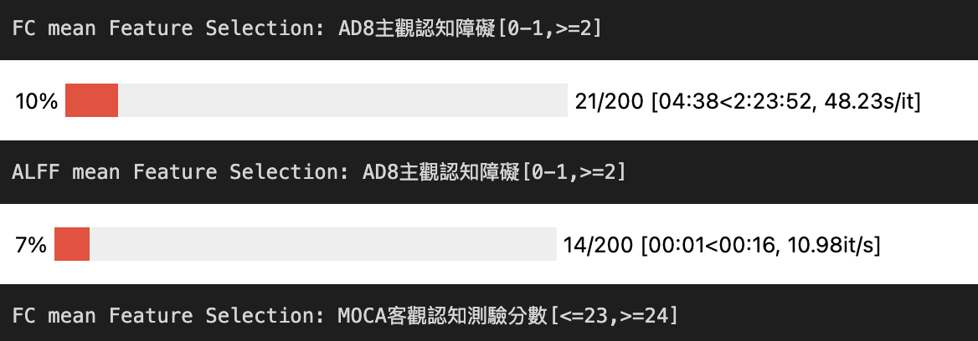
Problem

Slide 18
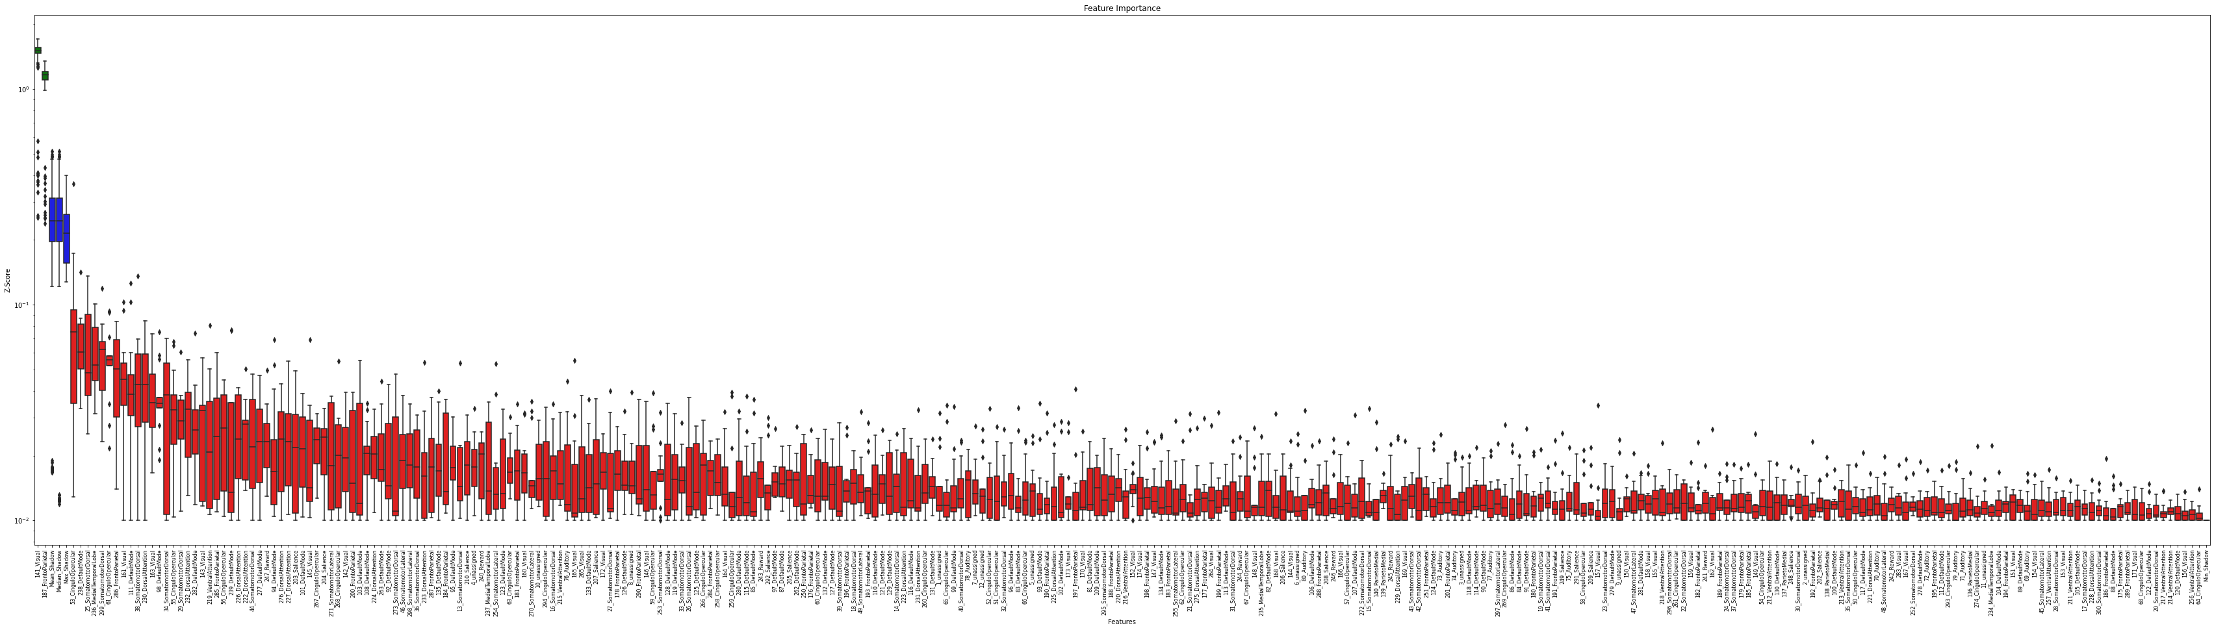
Boruta Shape – Plot Result

Slide 19
Cuda version crack
Cuda 10.2 can’t install at <=410. So, all model can’t use GPU resource.
Nvidia driver V.410
1080ti cuda 10.2 support [tensorflow<=1.12.0, torch <=1.9]
Nvidia driver V.510
3080ti cuda 11.6 support [tensorflow 1.16.0, torch 1.12.1.cuda]
Remove all system backup driver deb data
Delete all cuda environment and cuda-cudnn
Clear all system default apt-get package
Update all virtual environment
SCD, SGD-tf, SGD-pt, SGD-extend, lstm-exper
Done

Slide 20
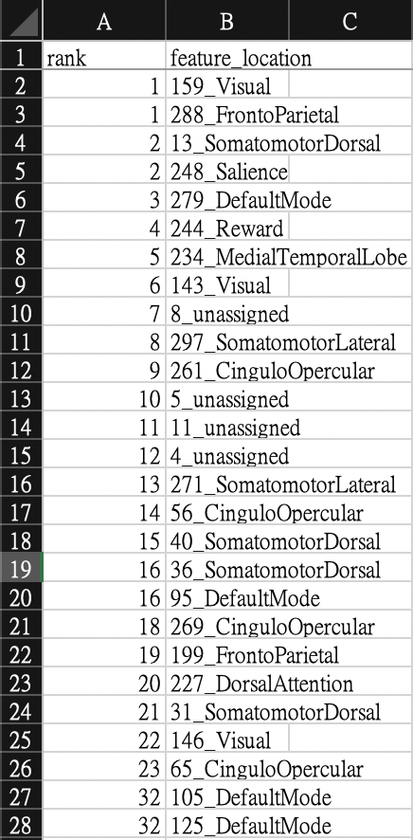
AD8 & MOCA [mean, variable] feature selection

Slide 21
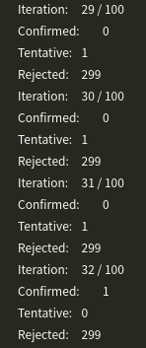
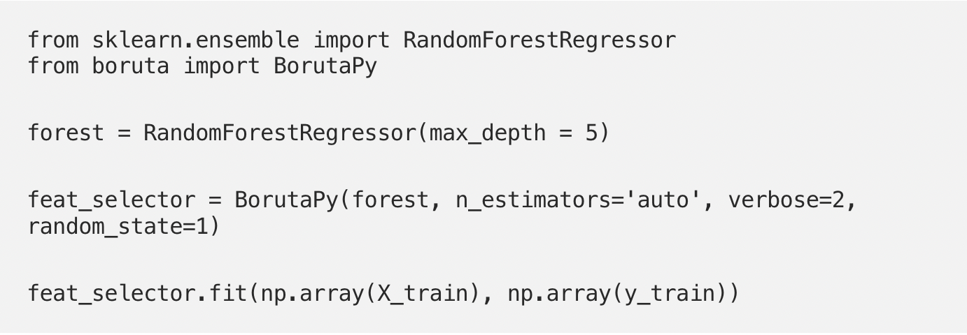
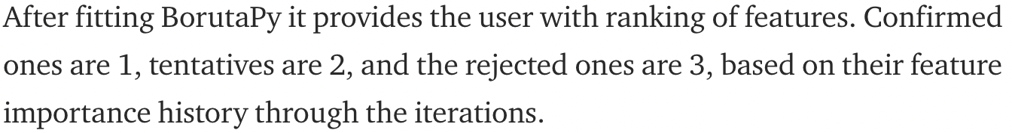
BorutaPy – e.g

Slide 22

BorutaPy – e.g

Slide 23
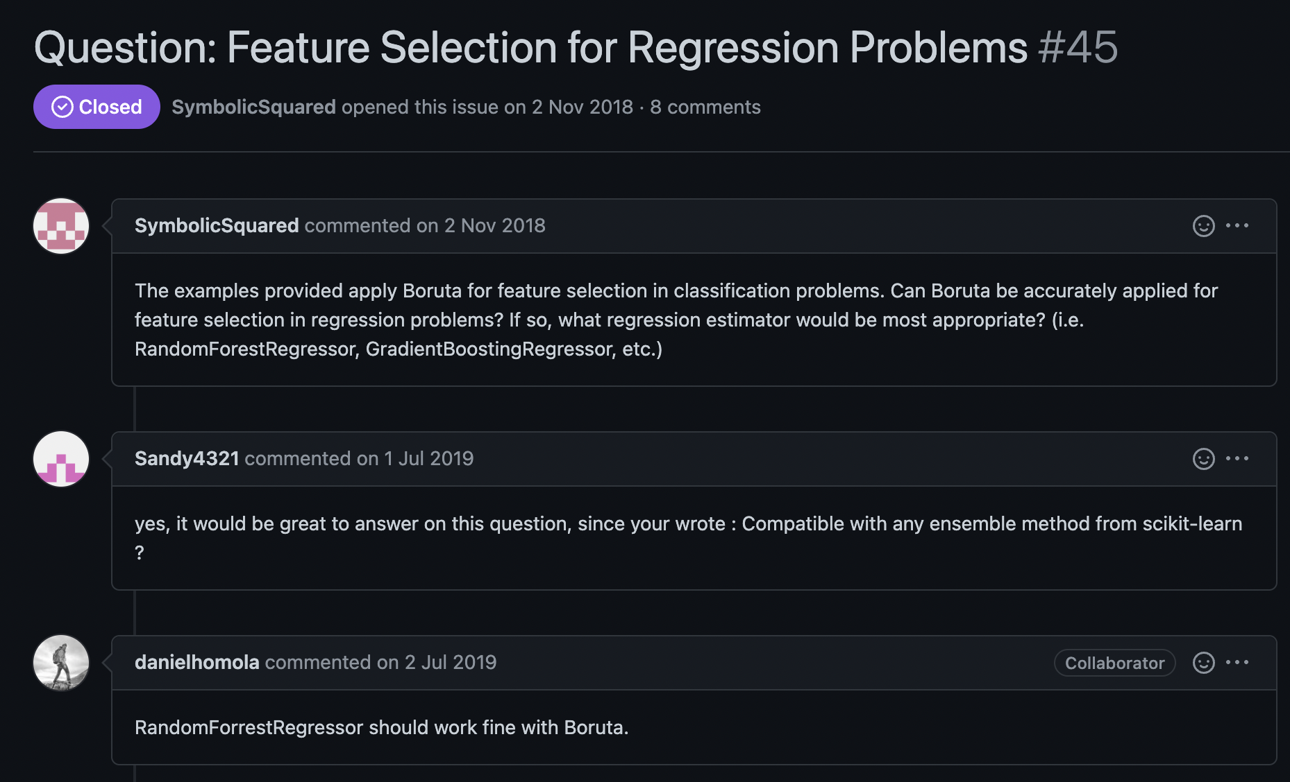
BorutaPy – e.g

Slide 24
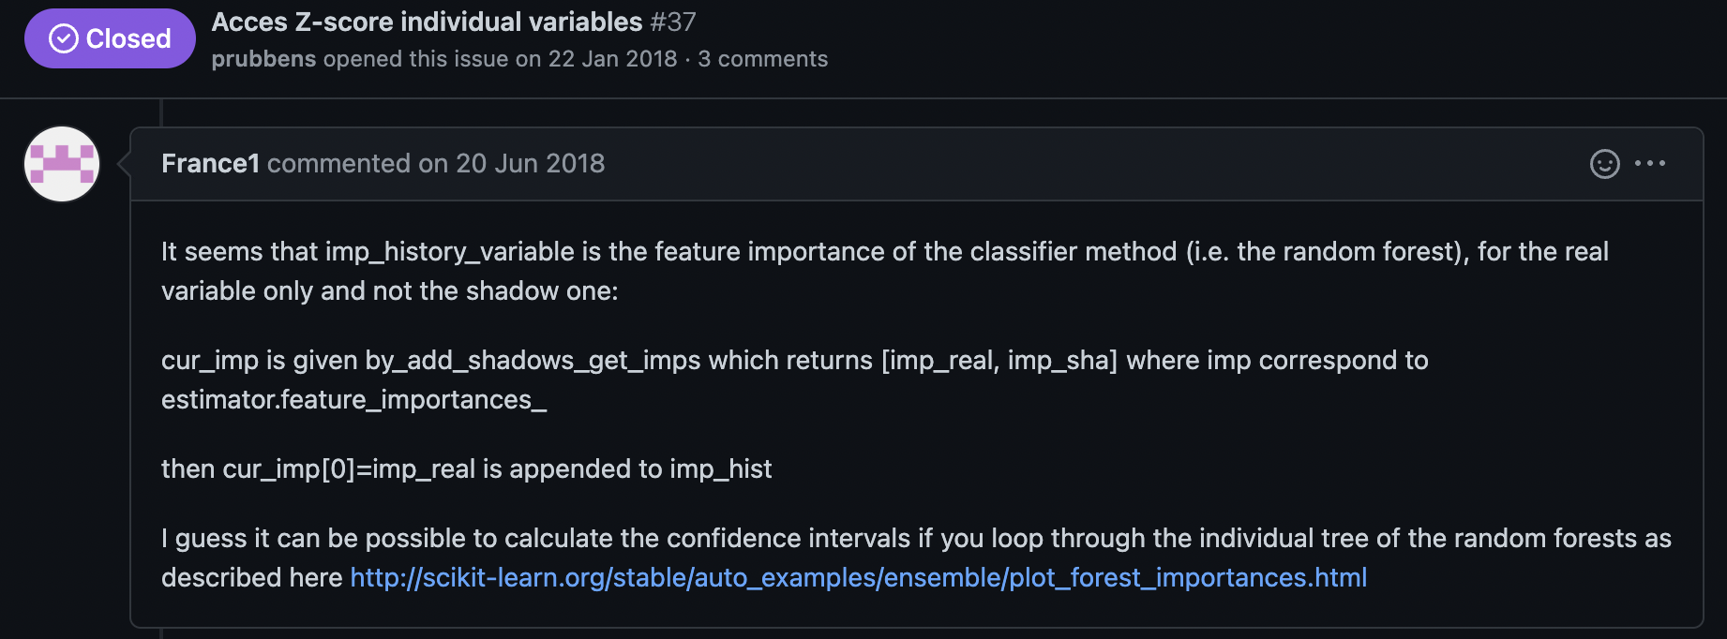
BorutaPy – e.g

Slide 25
Feature Selection – Boruta_pya
Boruta_py

Slide 26
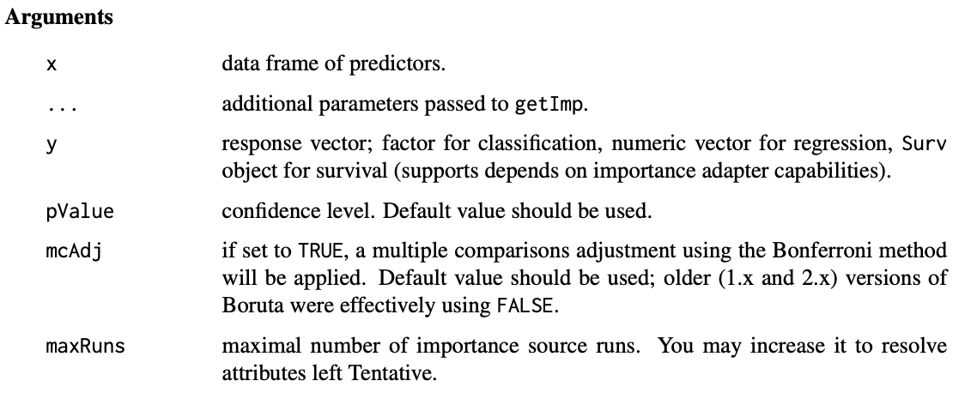
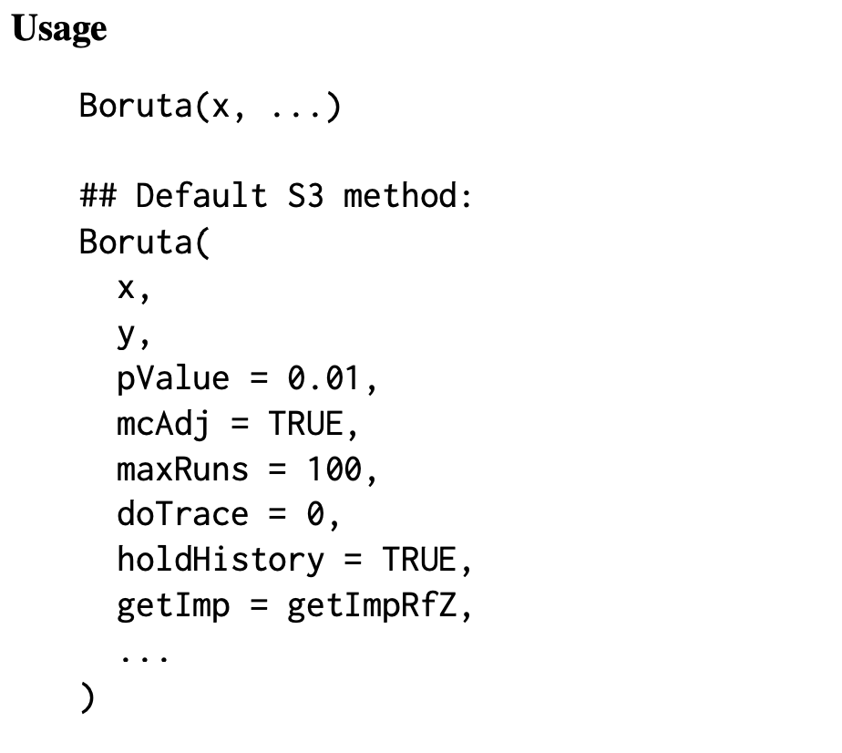
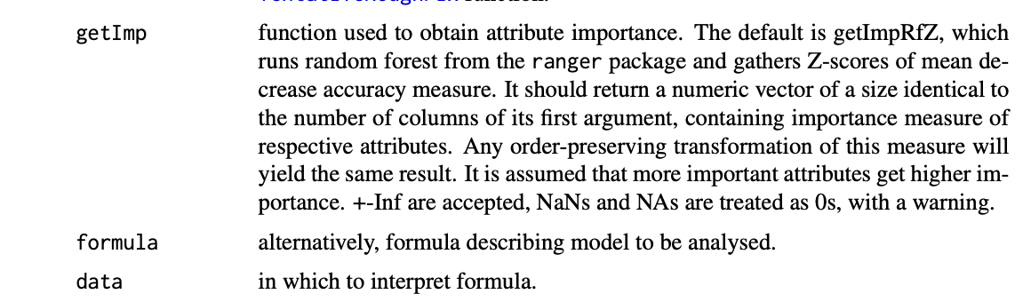
Feature Selection – Boruta-R
Paramter setting
Default

Slide 27
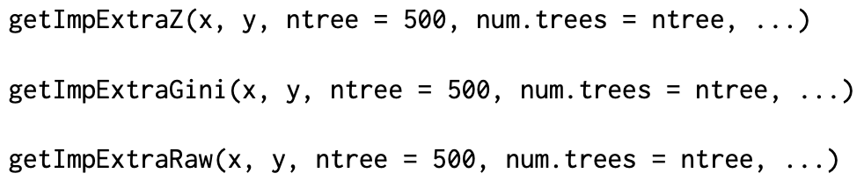
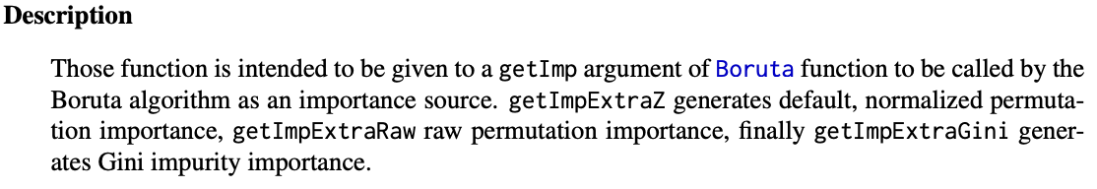
Feature Selection – Boruta-R
Important function.[Z-score, Gini, Raw]
E.g:

Slide 28
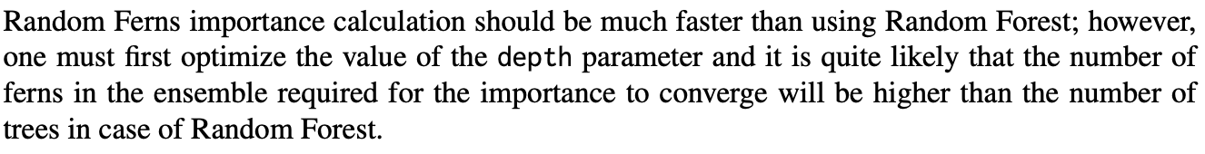
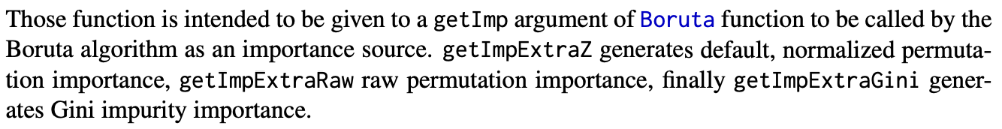
Feature Selection – Boruta-R
Imp config -getImp
getImpRf
Random Forest Z-Score
getImpFerns
Random Frens
getImpExtra
ExtraTrees
…
Notes:
RF 是經過挑選 (例如計算 GINI 、 information gain) 而決定是否要繼續修剪，ET則是隨機的修剪。RF 是經過訓練 (boosting )後選出的，ET 即用原本的資料集。

Slide 29
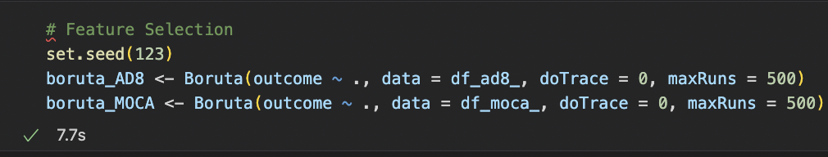
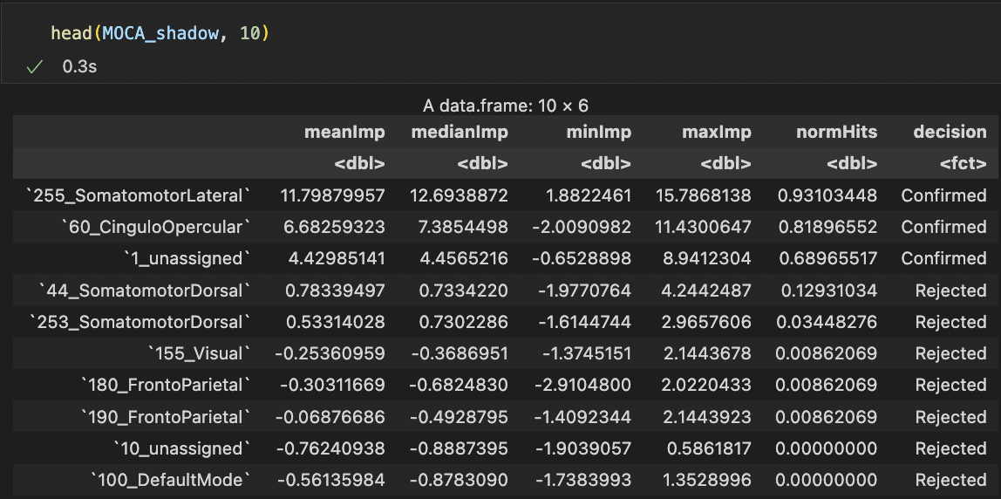
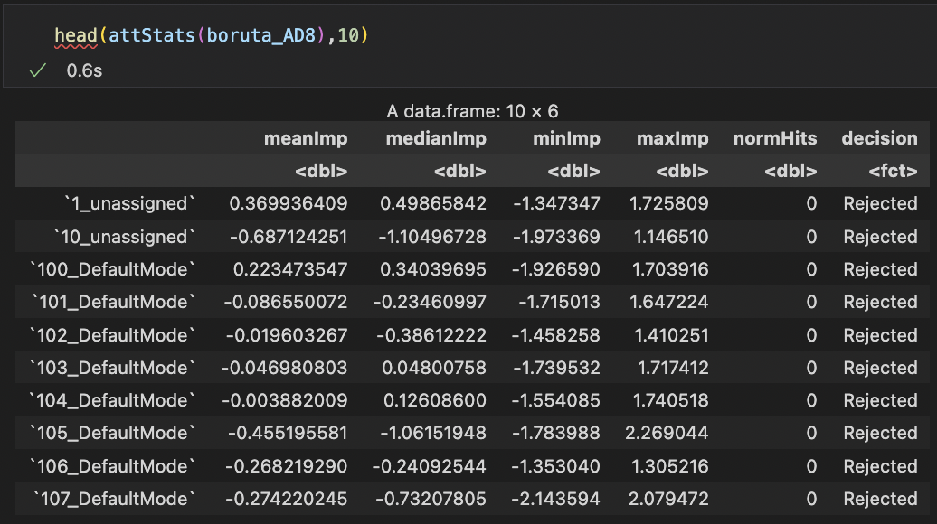
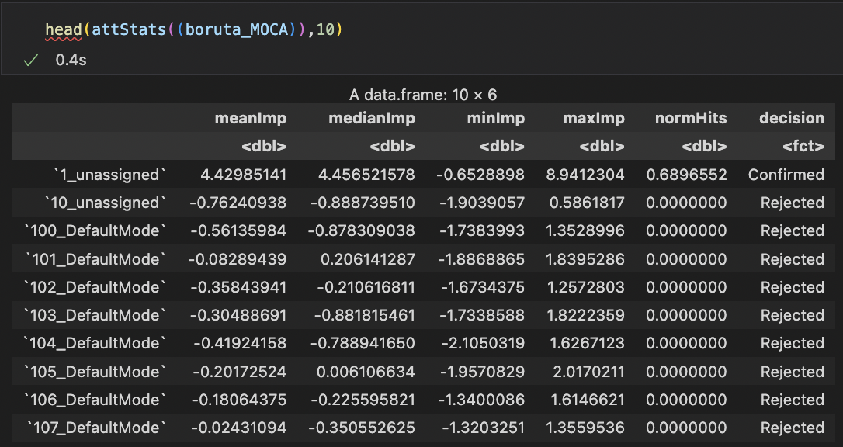

R-Boruta(default) – SCD AD8 & MOCA mean data
ALFF - mean
Notes:
Max run setting = 10000

Slide 30


BORUTA_PY - SCD AD8 & MOCA mean data
ALFF - mean

Slide 31


R-Boruta(default) – SCD AD8 & MOCA var data
ALFF - var

Slide 32


BORUTA_PY - SCD AD8 & MOCA var data
ALFF - var

Slide 33


Scikit-learn – base model config

Slide 34


R-Boruta – maxRuns [100, 500, 10000] e.g: alff-var-moca
100
500
10000

Slide 35



R-Boruta – maxRuns [100, 500, 10000] e.g: alff-mean-moca
100
500
10000

Slide 36
ALFF Results (default vs grid) – AD8
Method | Data type | model | Reg: mae (train) | Reg:mae (valid) | Reg: mse (train) | Reg: mse (valid) | Reg: mape (train) | Reg:mape (valid)
default | var | MLP | 1.85194 | 1.8093 | 5.208 | 4.527 | 1.029 | 0.999
 |  | XGBosst | 0.03717 | 2.05557 | 0.0053 | 5.74283 | 0.01598 | 1.16078
 |  | LightGBM | 1.85848 | 1.83569 | 5.27367 | 4.64871 | 1.03724 | 1.02063
 | mean | MLP | 1.85182 | 1.85004 | 4.98222 | 4.67611 | 1.01865 | 1.02169
 |  | XGBosst | 0.03539 | 2.04297 | 0.00548 | 6.19065 | 0.01782 | 1.1249
 |  | LightGBM | 1.85848 | 1.83569 | 5.27367 | 4.64871 | 1.03724 | 1.02063
 | Mix (var+mean) | MLP | 1.77742 | 1.82439 | 5.22427 | 4.83559 | 0.88937 | 0.91656
 |  | XGBosst | 0.00023 | 2.04974 | 0.0 | 6.67204 | 0.00013 | 1.08703
 |  | LightGBM | 1.85848 | 1.83569 | 5.27367 | 4.64871 | 1.03724 | 1.02063
GridSearch | var | MLP
 |  | XGBosst
 |  | LightGBM
 | mean | MLP
 |  | XGBosst
 |  | LightGBM
 | mix(var+mean) | MLP
 |  | XGBosst
 |  | LightGBM

Slide 37
ALFF Results (default vs grid) - MOCA
Method | Data type | model | Reg: mape (train) | Reg:mape (valid) | Reg: mse (train) | Reg: mse (valid) | Reg: mae (train) | Reg:mae (valid)
Base | var
 | mean
 | mix
GridSearch | var
 | mean
 | mix
Method | Data type | model | Reg: mae (train) | Reg:mae (valid) | Reg: mse (train) | Reg: mse (valid) | Reg: mape (train) | Reg:mape (valid)
default | var | MLP | 3.39916 | 2.80821 | 15.86491 | 10.79148 | 0.14028 | 0.11676
 |  | XGBosst | 0.07055 | 2.91438 | 0.02007 | 10.90134 | 0.00277 | 0.11876
 |  | LightGBM | 3.07804 | 2.75 | 12.88866 | 10.47626 | 0.12699 | 0.11344
 | mean | MLP | 3.10224 | 2.74102 | 13.55305 | 10.44101 | 0.12714 | 0.11275
 |  | XGBosst | 0.00023 | 3.42887 | 0.0 | 15.71528 | 0.00005 | 0.14074
 |  | LightGBM | 3.07804 | 2.75 | 12.88866 | 10.47626 | 0.12699 | 0.11344
 | Mix (var+mean) | MLP | 3.11493 | 2.69746 | 13.42488 | 10.02784 | 0.12593 | 0.10999
 |  | XGBosst | 0.00021 | 2.64143 | 0.0 | 10.32481 | 0.00005 | 0.10951
 |  | LightGBM | 3.07804 | 2.75 | 12.88866 | 10.47626 | 0.12699 | 0.11344
GridSearch | var | MLP
 |  | XGBosst
 |  | LightGBM
 | mean | MLP
 |  | XGBosst
 |  | LightGBM
 | Mix (var+mean) | MLP
 |  | XGBosst
 |  | LightGBM

Slide 38
ALFF Results (default vs feature selction) – AD8
Method | Data type | model | Reg: mae (train) | Reg:mae (valid) | Reg: mse (train) | Reg: mse (valid) | Reg: mape (train) | Reg:mape (valid)
default | var | MLP | 1.85194 | 1.8093 | 5.208 | 4.527 | 1.029 | 0.999
 |  | XGBosst | 0.03717 | 2.05557 | 0.0053 | 5.74283 | 0.01598 | 1.16078
 |  | LightGBM | 1.85848 | 1.83569 | 5.27367 | 4.64871 | 1.03724 | 1.02063
 | mean | MLP | 1.85182 | 1.85004 | 4.98222 | 4.67611 | 1.01865 | 1.02169
 |  | XGBosst | 0.03539 | 2.04297 | 0.00548 | 6.19065 | 0.01782 | 1.1249
 |  | LightGBM | 1.85848 | 1.83569 | 5.27367 | 4.64871 | 1.03724 | 1.02063
 | Mix (var+mean) | MLP | 1.77742 | 1.82439 | 5.22427 | 4.83559 | 0.88937 | 0.91656
 |  | XGBosst | 0.00023 | 2.04974 | 0.0 | 6.67204 | 0.00013 | 1.08703
 |  | LightGBM | 1.85848 | 1.83569 | 5.27367 | 4.64871 | 1.03724 | 1.02063
Feature Selection [Grid: False] | Var [threshold < 60] | MLP | 1.78989 | 1.76341 | 5.73611 | 5.1215 | 0.74076 | 0.72058
 |  | XGBosst | 0.00026 | 1.57441 | 0.0 | 4.3907 | 0.00014 | 0.6559
 |  | LightGBM | 1.85848 | 1.83569 | 5.27367 | 4.64871 | 1.03724 | 1.02063
 | Mean [threshold < 60] | MLP | 1.97053 | 1.87442 | 5.52175 | 4.64327 | 1.18607 | 1.11812
 |  | XGBosst | 0.00025 | 1.79522 | 0.0 | 4.86236 | 0.00014 | 1.0239
 |  | LightGBM | 1.85848 | 1.83569 | 5.27367 | 4.64871 | 1.03724 | 1.02063
 | Mix (var+mean) | MLP
 |  | XGBosst
 |  | LightGBM

Slide 39
ALFF Results (default vs feature selction) - MOCA
Method | Data type | model | Reg: mape (train) | Reg:mape (valid) | Reg: mse (train) | Reg: mse (valid) | Reg: mae (train) | Reg:mae (valid)
Base | var
 | mean
 | mix
GridSearch | var
 | mean
 | mix
Method | Data type | model | Reg: mae (train) | Reg:mae (valid) | Reg: mse (train) | Reg: mse (valid) | Reg: mape (train) | Reg:mape (valid)
default | var | MLP | 3.39916 | 2.80821 | 15.86491 | 10.79148 | 0.14028 | 0.11676
 |  | XGBosst | 0.07055 | 2.91438 | 0.02007 | 10.90134 | 0.00277 | 0.11876
 |  | LightGBM | 3.07804 | 2.75 | 12.88866 | 10.47626 | 0.12699 | 0.11344
 | mean | MLP | 3.10224 | 2.74102 | 13.55305 | 10.44101 | 0.12714 | 0.11275
 |  | XGBosst | 0.00023 | 3.42887 | 0.0 | 15.71528 | 0.00005 | 0.14074
 |  | LightGBM | 3.07804 | 2.75 | 12.88866 | 10.47626 | 0.12699 | 0.11344
 | Mix (var+mean) | MLP | 3.11493 | 2.69746 | 13.42488 | 10.02784 | 0.12593 | 0.10999
 |  | XGBosst | 0.00021 | 2.64143 | 0.0 | 10.32481 | 0.00005 | 0.10951
 |  | LightGBM | 3.07804 | 2.75 | 12.88866 | 10.47626 | 0.12699 | 0.11344
Feature Selection [Grid: False] | Var [threshold < 60] | MLP | 3.48935 | 2.90119 | 16.78346 | 12.0541 | 0.13982 | 0.11483
 |  | XGBosst | 0.00027 | 2.53037 | 0.0 | 8.87677 | 0.00001 | 0.10404
 |  | LightGBM | 3.07804 | 2.75 | 12.88866 | 10.47626 | 0.12699 | 0.11344
 | Mean [threshold < 60] | MLP | 3.15256 | 2.50891 | 13.78646 | 0.26121 | 0.12821 | 0.10187
 |  | XGBosst | 0.00027 | 3.52621 | 0.0 | 17.71686 | 0.00005 | 0.1436
 |  | LightGBM | 3.07804 | 2.75 | 12.88866 | 10.47626 | 0.12699 | 0.11344
 | Mix (var+mean) | MLP
 |  | XGBosst
 |  | LightGBM

Slide 40

Model parameter config

Slide 41


ALFF – Default model

Slide 42


ALFF – Non-GridSearch Resutls [top rank = 60]

Slide 43


ALFF – GridSearch Resutls [top rank = 60]
Default
Notes:
e.g:
Max run 10000 set top 80. (add Ranking import : age, edu)
Overall model feature selection.
Un-super 群聚分析.

Slide 44


FC – Default model

Slide 45


FC – Non-GridSearch Resutls [top rank = 100]

Slide 46


FC – GridSearch Resutls [top rank = 100]
Default

Slide 47



ALFF – GridSearch Resutls [top rank = 60] Fusion
Defautl – Mix [var / mean]
GridSearch – Mix [var / mean] Feature Selection : False
GridSearch – Mix [var / mean] Feature Selection : True

Slide 48
Model predict(x)
Train valid test -> overall or cross validation (cv)
E.g: mean, var, mix (alff: 8 & 80, fc: )
feature
Cluster feature - Ranking top or confirm feature?
Both
Notes:
*EDA
*Raid mark

Slide 49


Alff mix top-8 & top-80
Feature : Top - 8
Feature: Top - 80

Slide 50


R error
Notes:
FC

